Slide 1
Principles of management of eczema/ dermatitis
Dr. Indira Kahawita
Consultant Dermatologist
BH Homagama

Slide 2
Objectives
Be familiar with varying presentations of eczema
Be aware of principles of managing uncomplicated eczema
Be aware when to refer
Be aware of other conditions that may mimic eczema

Slide 3
Pathophysiology of eczema
“the allergic march” temporal progression of atopic symptoms: atopic eczema, allergic rhinoconjunctivitis, airway hyper responsiveness and asthma over time is well known

Slide 4
Skin barrier dysfunction
Dry skin of lesional and non lesional skin and Increased trans epidermal water loss (TEWL)
Defective permeability barrier
Stress genetic predisposition
Altered lipid composition (ceramides)
Environmental factors (soap, long term steroids, house dust mite, Staph infections

Slide 5
Genetic factors
Genetic linkage to chromosome 1q21
Two functional mutations in filaggrin gene strongly associated with atopic eczema
Filaggrin is important to maintenance of the skin barrier function

Slide 6
Triggers for atopic eczema
Food and aeroallergens
About 40% children with moderate to severe AD have food allergy (commonest is egg)
House dust mite may trigger eczematous rash
Infective agents
Susceptible to many infections
About 90% have Staph. Aureus – exotoxins can trigger inflammatory mediators
Vaccinia virus infection
Head and neck lesions may be affected by Malassezia furfur

Slide 7
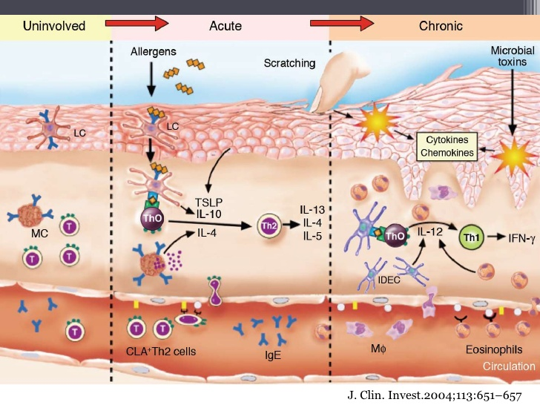
Immunology of atopic eczema

Slide 8
Many faces of eczema
Endogenous vs. exogenous
Acute vs. chronic
Allergic vs. irritant
Presentations at different ages

Slide 9
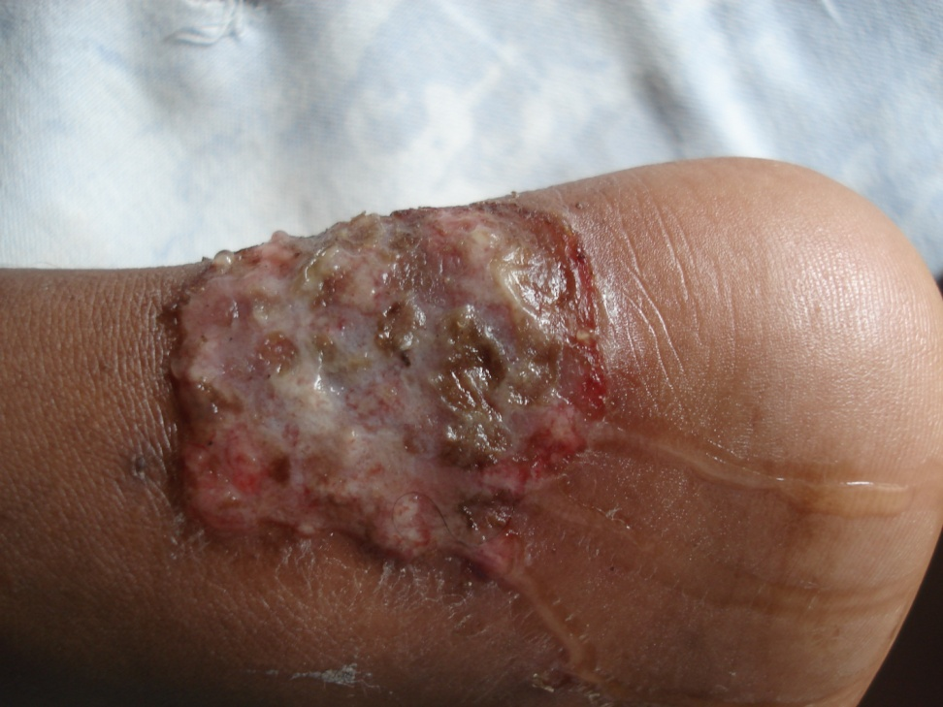
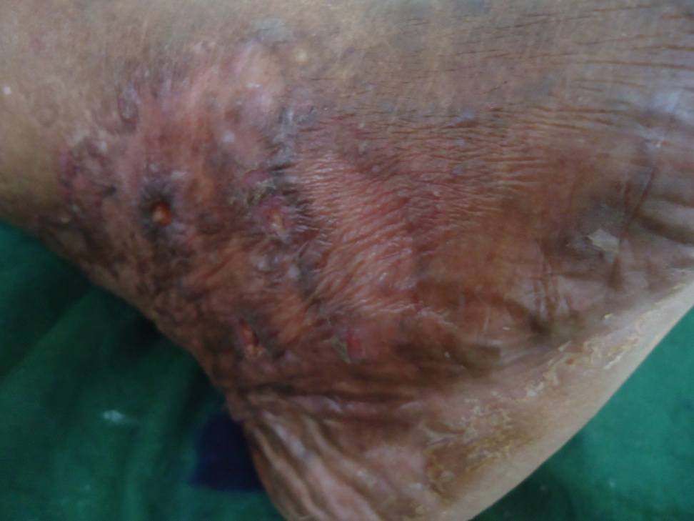
Acute vs. chronic
Acute eczema
Chronic eczema

Slide 10
Acute eczema
Presentations
Management
Intense itching
Oozing, vesicles, blisters
Erythema
Secondary infection
Surrounding erythema
Regional lymphadenopathy
fever
Rest
Oral/ IV antibiotics
Condy’s(KMnO4) compresses
Oral steroids
Antihistamines

Slide 11
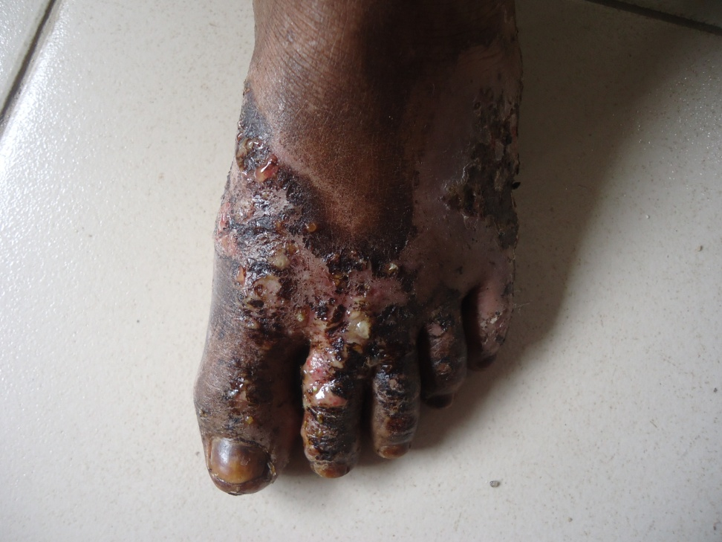
Use of condy’s solution
Correct dilution is 1:8000
Very light pink, dilute solution
Use a compress if severe oozing
Washes can be used in slightly wet lesions
No use in dry lesions

Slide 12
Sub acute eczema
Presentations
Management
Pain, stinging, burning
Mild to moderate itch
Redness
Scaling and fissuring
Scalded appearance
Condy’s washes
Topical steroid creams +/- antibiotics
Anti histamines

Slide 13
Chronic eczema
Presentations
Management
Moderate to severe itch
Lichenification/ thickening of skin
Accentuation of skin lines
Pigmentation
Fissuring
Topical steroid ointments (under occlusion)
Emollients/ keratolytics
Oral steroids
Anti histamines

Slide 14
Endogenous vs. exogenous eczema
Endogenous eczema
Exogenous eczema
Early onset
associated atopy
Asthma
Allergic rhinoconjunctivitis
May need to treat other atopic manifestations as well
Any age
External cause
Allergen
Irritant
Avoidance of external cause essential in management

Slide 15
Allergic vs. irritant
Allergic contact dermatitis (ACD)
Irritant contact dermatitis (ICD)
Genetic predisposition
Prior sensitization necessary
Delayed type hypersensitivity
Only due to certain substances (e.g. rubber related products in footwear contact dermatitis)
In anyone
May occur at first contact
No immunologic basis
Any substance may be irritant if applied in sufficient amounts (e.g. water)
Hand eczema due to water and detergents is a common form of ICD

Slide 16
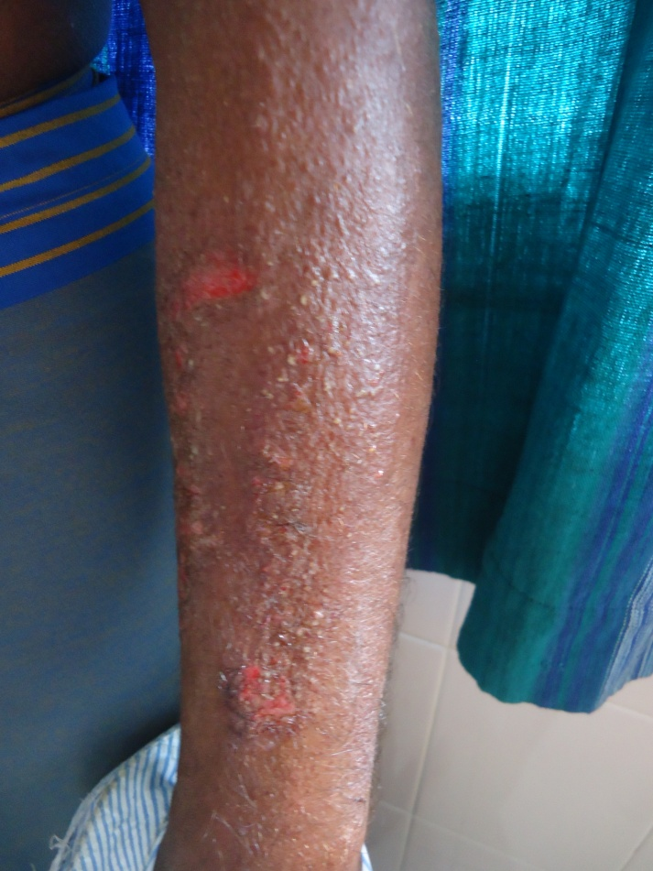
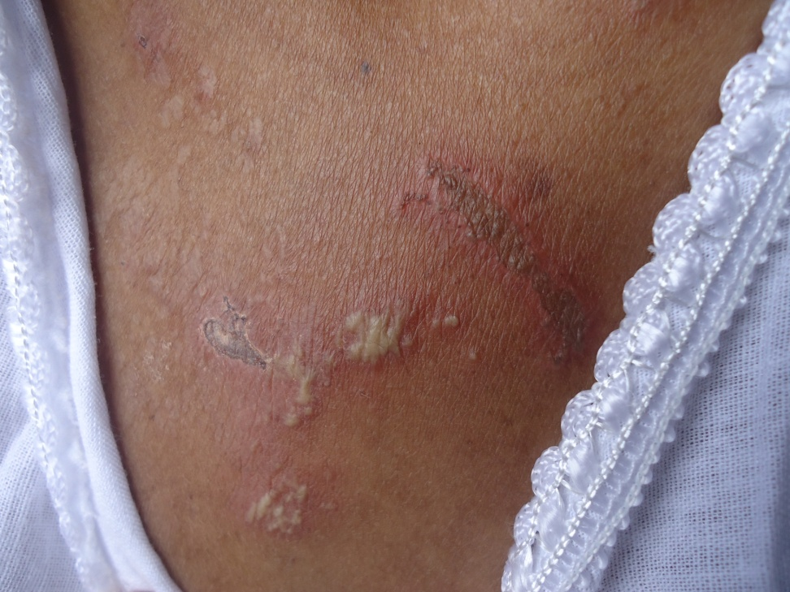
Allergic contact dermatitis
Blister beetle dermatitis
Plant contact dermatitis (badulla)

Slide 17
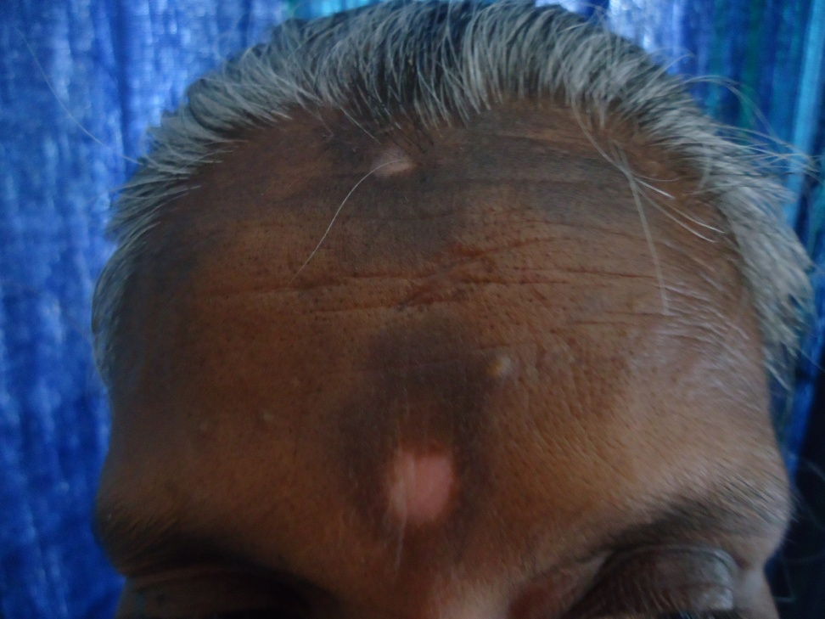
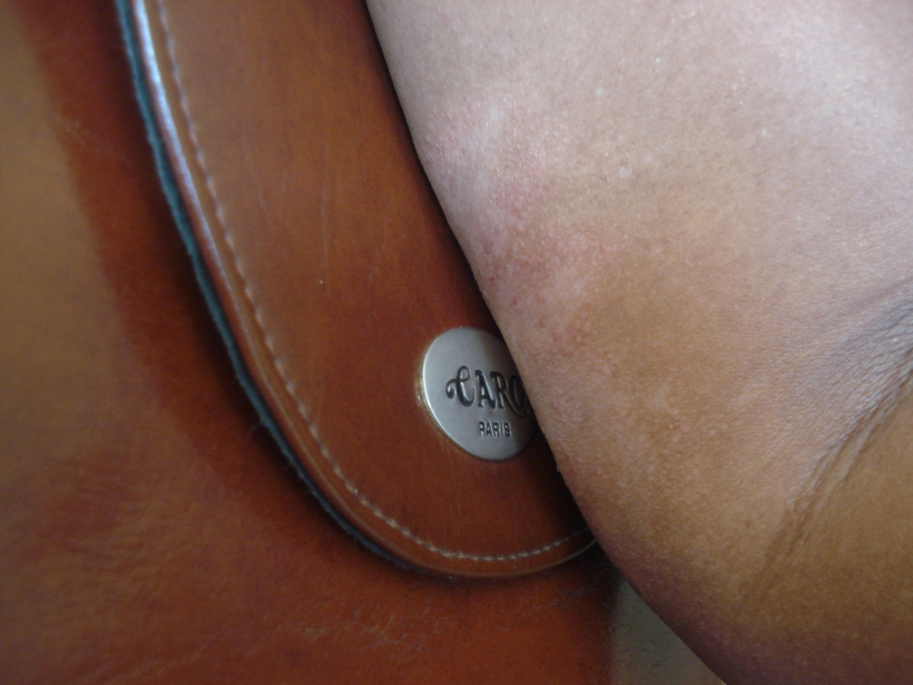
Allergic contact dermatitis
Allergic (red dye in pottu)
Allergic (nickel in accessories)

Slide 18
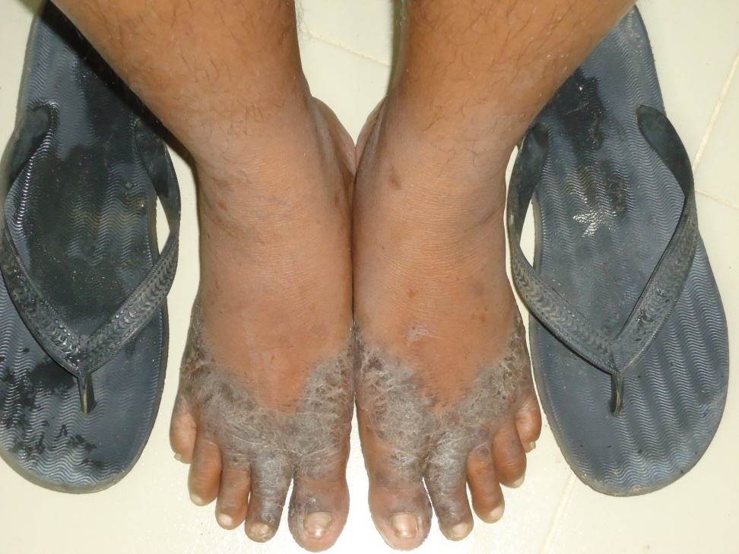
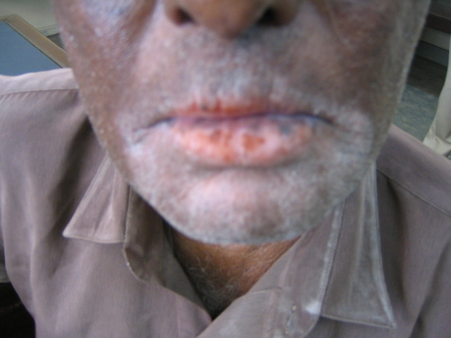
Allergic contact dermatitis
Hair dye
Rubber slippers

Slide 19
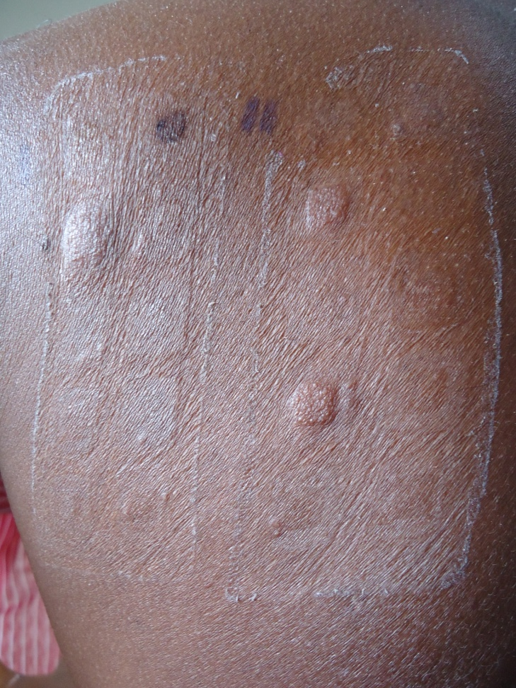
Diagnosis of allergic contact dermatitis
Thorough history to establish allergen
Pattern of involvement
Patch testing to identify the specific allergens

Slide 20
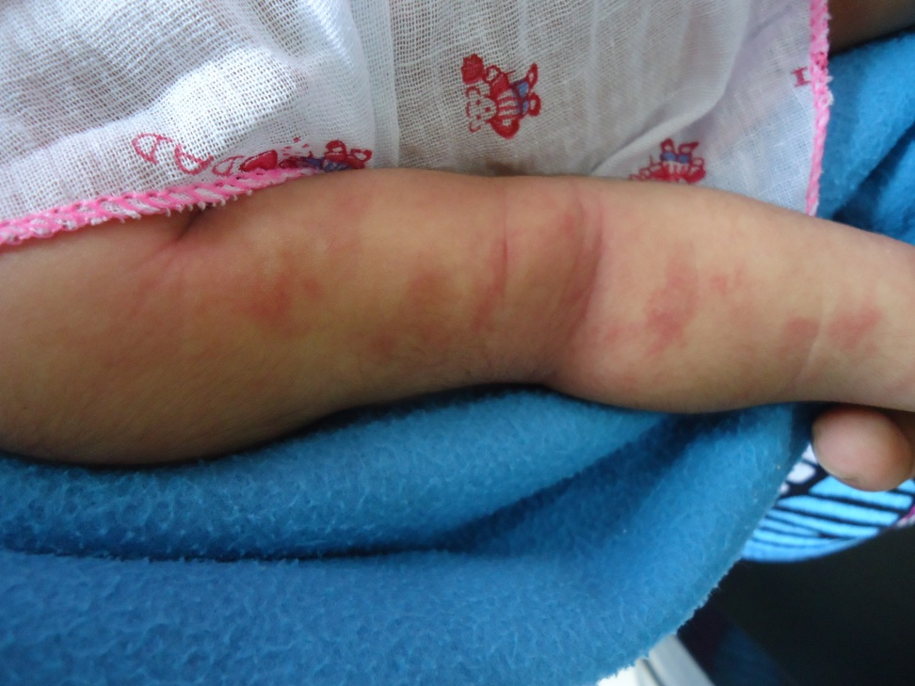
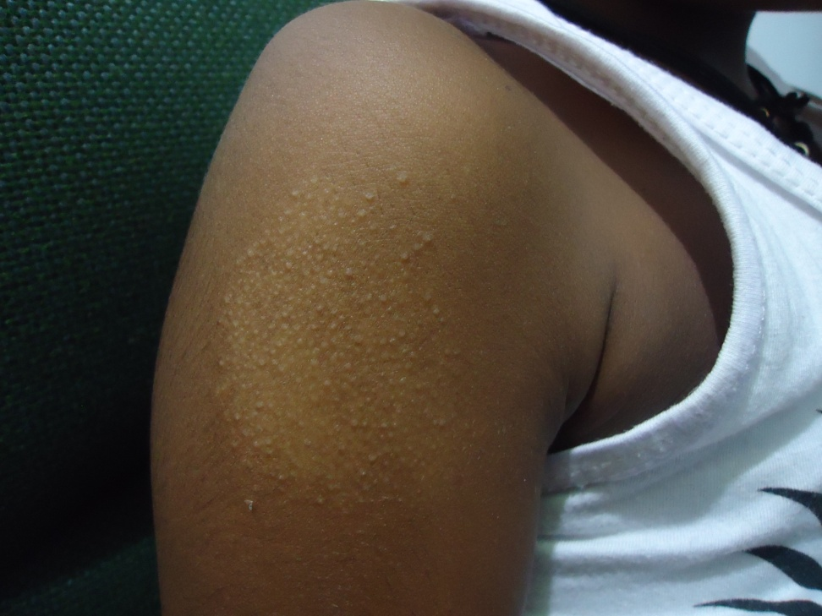
Presentations at different ages
Infant (atopic eczema)
Child

Slide 21
Atopic eczema
It is the “itch that rashes, not the rash that itches”
Itching and an abnormally dry skin are the essential features
Areas of involvement
Infants – face (cheeks, perioral area) and flexures
Pre schoolers – flexures of limbs (cubital fossa, beck of knee)
Older children – lower limbs

Slide 22
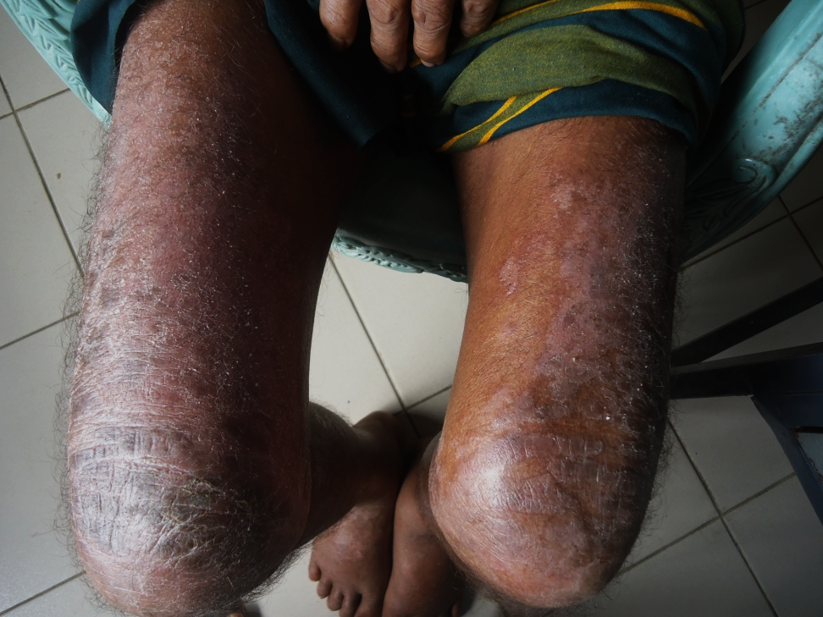
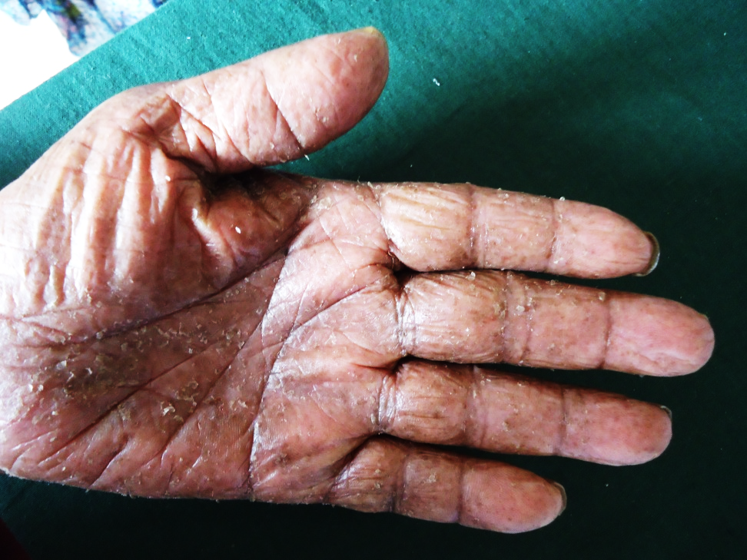
Presentations at different ages
Adult
Adult

Slide 23
Important principles to remember
Co existence of inflammation, bacterial and fungal infections is very rare
Hence use of triple combinations should be avoided
If in doubt treat the possible infection first
Use the mildest possible steroid as the first line therapy

Slide 24
Use of topical steroids
facts to consider
Potency of the steroid
Cream vs. ointment
Site of application
Amount to be used
Frequency of application
Duration of therapy

Slide 25
Group | Preparation
I | Clobetasiol propionate cream, ointment 0.05%
II | Betameathasone dipropionate ointment 0.05% Mometasone furoate ointment 0.1%
III | Betamethasone dipropionate cream 0.05% Betamethasone valerate ointment 0.1% Fluticasone propionate ointment 0.005% (cutivate)
IV | Betamethasone valerate lotion 0.1% Fluocinalone acetonide cream 0.2% Fluocinalone acetonide ointment 0.025% hydrocortisone valerate ointment 0.2% Mometasone furoate cream 0.1%
V | Betamethasone dipropionate lotion 0.02% Betamethasone valerate cream 0.1% Fluocinalone acetonide cream 0.025% Fluticasone propionate cream 0.05%
VI | Betamethasone valerate lotion 0.1% Desonide cream 0.05% (desowen)
VII | Hydrocortisone cream 1%, 0.5% (generics)

Slide 26
What preparation to use?
Creams for sub acute eczema, mildly wet lesions
Ointment for dry lesions
Lotions for scalp lesions
Gels and foams are not commonly available in Sri Lanka

Slide 27
Frequency of application
No hard data on the best method
Overnight application (once daily)
On hydrated skin
With / without occlusion
Twice daily applications only in severe disease
Think about the practical issues!

Slide 28
Site of application
Thick skin (palms, soles, lichenified eczema) needs potent steroids
Betamethasone is a good choice for arms/ legs/ trunk
Use mild steroids (hydrocortisone) in flexures, scrotum, groin, axillae, eyelids, face and also in infants!

Slide 29
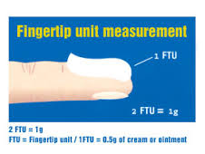
Amount to be applied
Use the least possible amount that will be efficacious
Sufficient to apply preparation to a give a slight shine to the skin
One “fingertip unit” Is equal to 0.5g cream/ointment
Half a “FTU” may be spread out in an area covered by the palm

Slide 30
Are combinations useful?
In most instances combinations of steroids and antibiotics/ antifungals are not indicated
Triple combinations are of no value
Dilution of steroids in emollients may be of use when large areas are affected.
In small lesions application of the emollient over the steroid may be useful, but better to keep a few hours’ gap between the two applications.

Slide 31
What happens with repeated applications?
Tachyphylaxis: reduced efficacy of potent topical steroids following repeated applications (use for less than 2 weeks)
Preparation | Length of therapy | Grams per week
Clobetasol propionate | 14 days | 60
Clobetasol scalp solution | 14 days | 50 ml
Betamethasone dipropionate | unrestricted | 45

Slide 32
A practical approach to use of topical steroids
Use the most suitable steroid
Use together with emollients
Continue using as long as lesions are active (itching, redness, roughness)
Continue using the emollient for a longer period
Sometimes intermittent dosing (use twice weekly) may be useful if there are frequent recurrences

Slide 33
Adverse effects of topical steroids
Skin atrophy, telangiectasia
Purpura, striae
Steroid rosacea, acne,
Perioral dermatitis
Tinea incognito
Ocular hypertension, glaucoma, cataracts
Systemic absorption
Allergic contact dermatitis
Rebound phenomenon
Non healing leg ulcers
Hypo pigmentation
Hypertrichosis of face

Slide 34
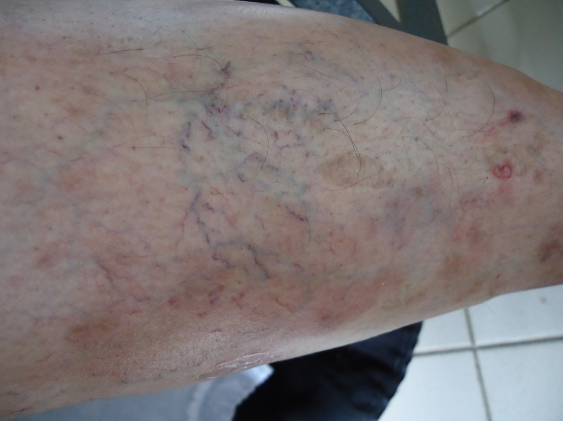
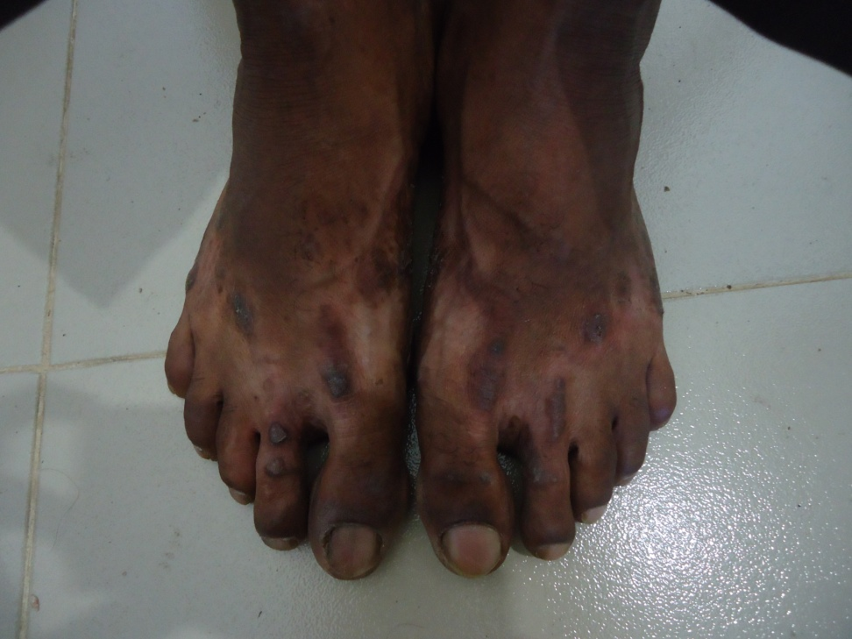
Steroids may give rise to……
Skin atrophy
Hypopigmentation

Slide 35
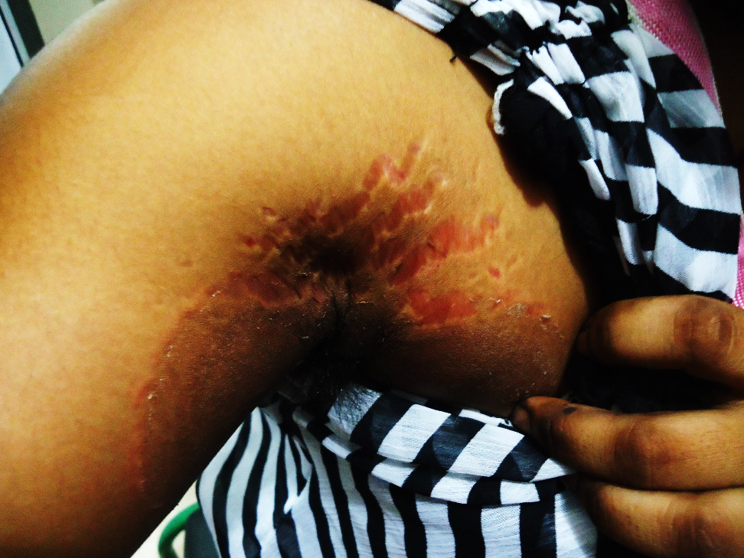
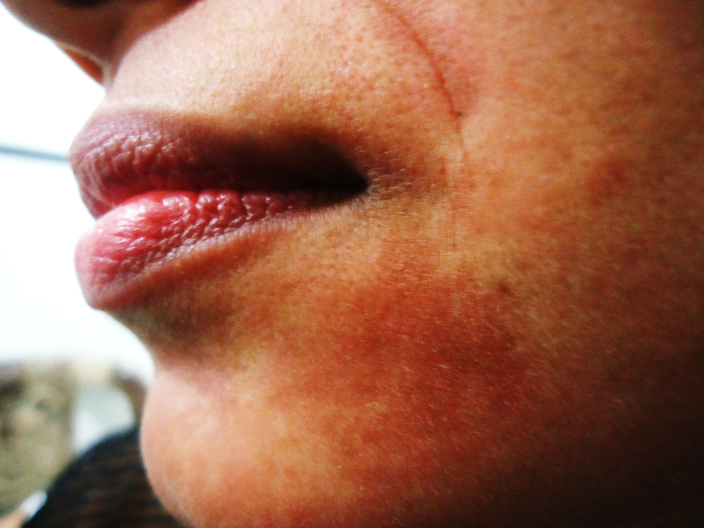
Steroids may give rise to
Striae
Telangiectasia

Slide 36
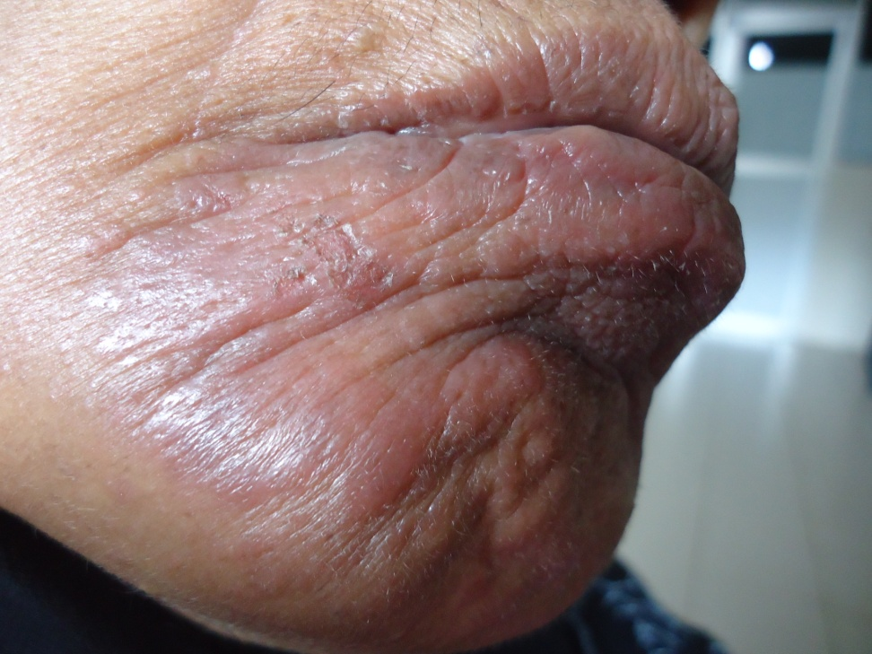
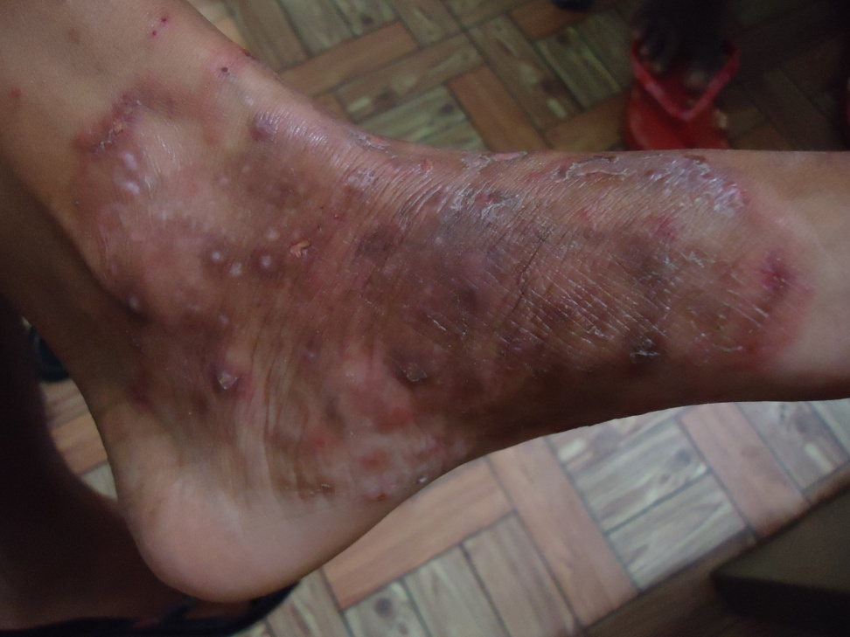
Steroids may give rise to……
Perioral dermatitis
Tinea incognito

Slide 37
Use of emollients
Most eczemas arise due to underlying dry skin
Hence skin hydration plays an important role in management
Best applied few hours after steroids (night time application)
Use one to four times daily
Apply just after bath/ wash (when skin patted dry)

Slide 38
Which emollient to use?
Aqueous cream
Emulsifying ointment
10% urea in aqueous cream (in very dry skin)
Commercial preparations
White soft paraffin
Combination emollients
Vegetable based preparations (colloidal oatmeal)
Ceramide containing preparations
Zyndet preparations

Slide 39
What about soaps?
Ordinary Soaps may cause skin pH to rise hence causing dryness
Soap substitutes may be used
Emulsifying ointment
Aqueous cream
Commercially available soap substitutes
Bath oils/ additives
Consider practical and economic issues when prescribing soaps. Remember Sri Lankans prefer a cake of soap and also they are likely to give undue importance to the soap

Slide 40
Second line drugs
Topical tacrolimus
Oral steroids
Steroid sparing agents
Azathioprine
Methotrexate
Phototherapy

Slide 41
Photodermatitis
In areas exposed to sun
Face
Extensor upper limbs
Back of neck
Front of chest
Many presentations
Pityriasis alba in children
Hypopigmented papular lesions
Eczematous lesions
Lichenoid lesions

Slide 42
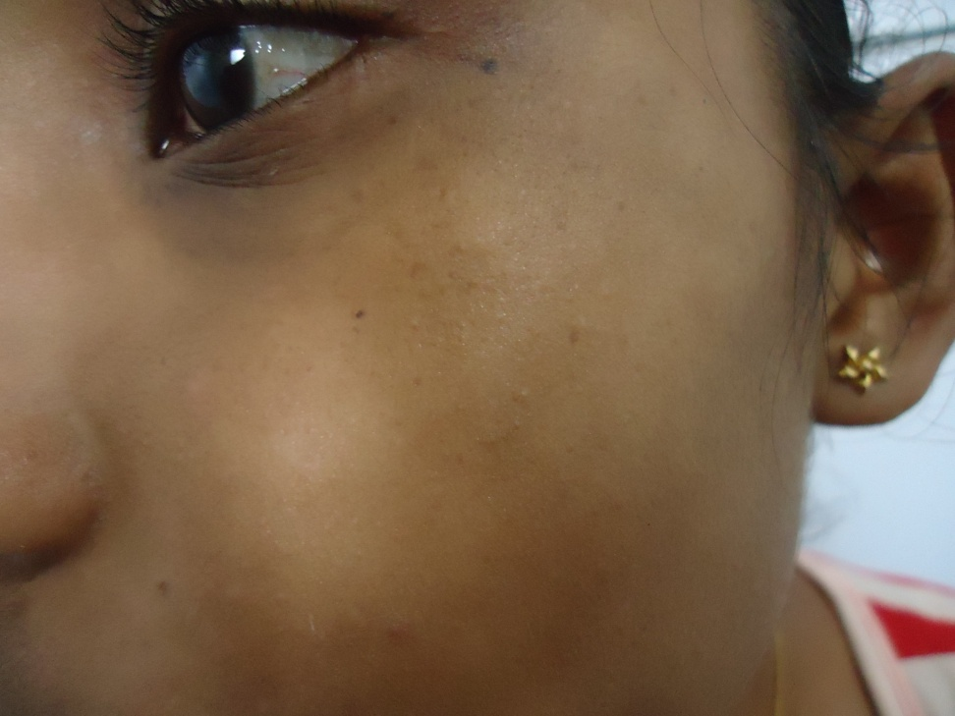
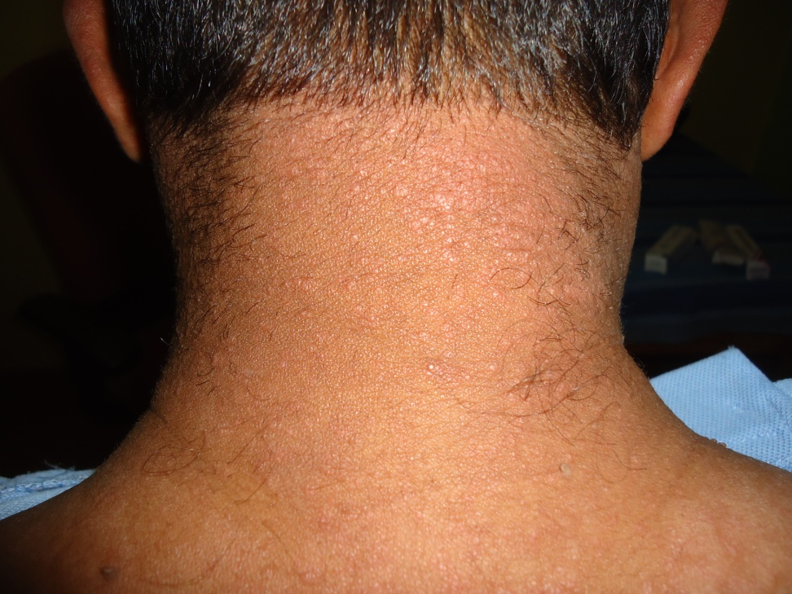
photodermatitis
P. alba
Erythematous papules

Slide 43
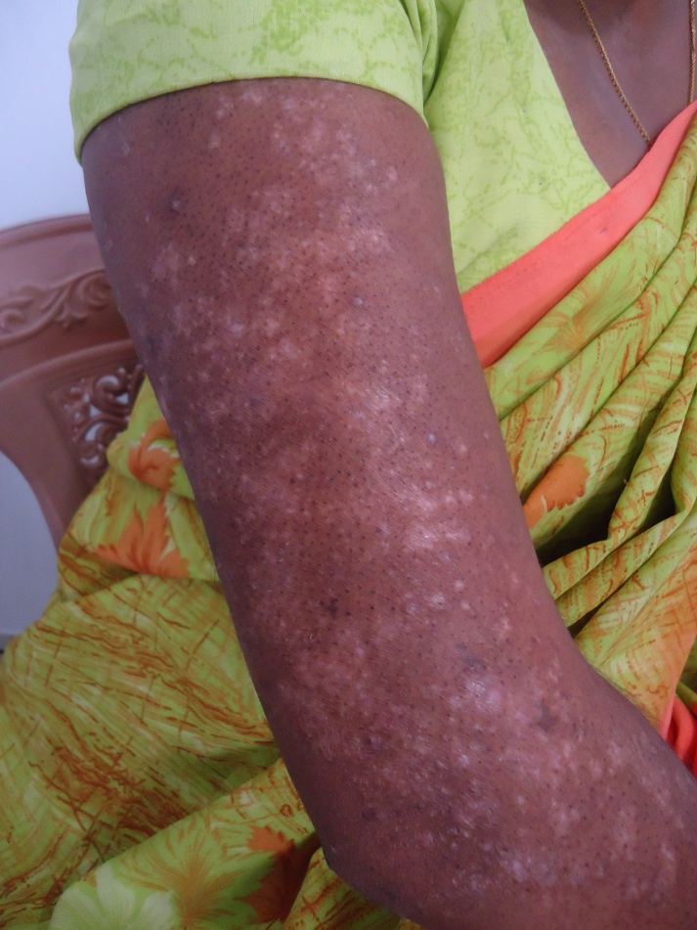
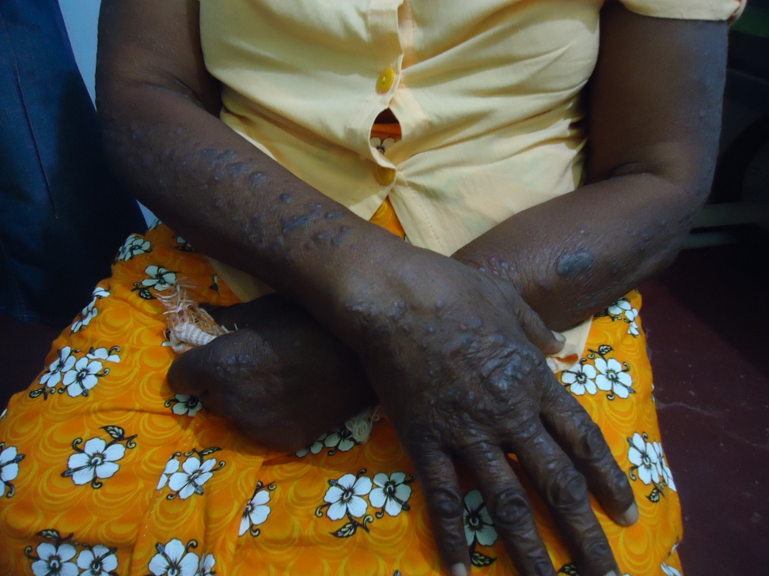
Photodermatitis
Hypopigmented lesions
Lichenoid lesions

Slide 44
Principles of management
Treatment of the existing lesions (steroids, emollients)
Avoidance of sun exposure
Avoid going out in the sun
Use sun protection (hats, umbrellas, covering clothing)
Use sunscreens

Slide 45
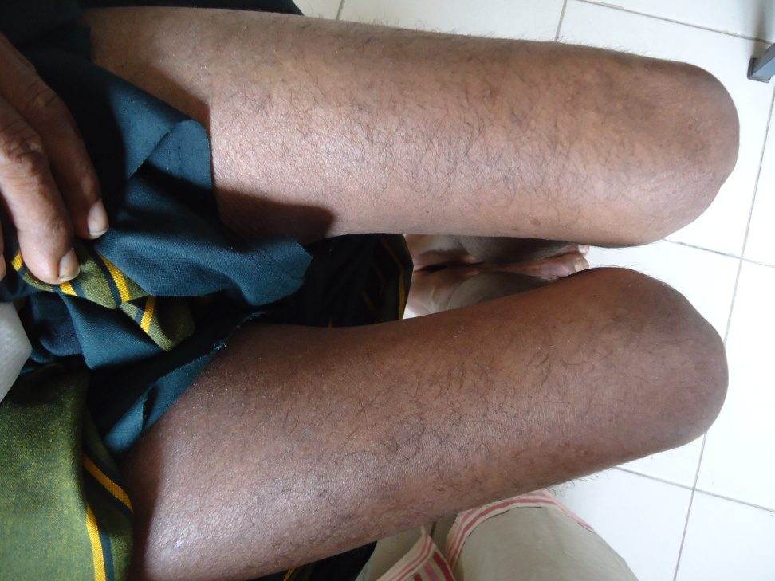
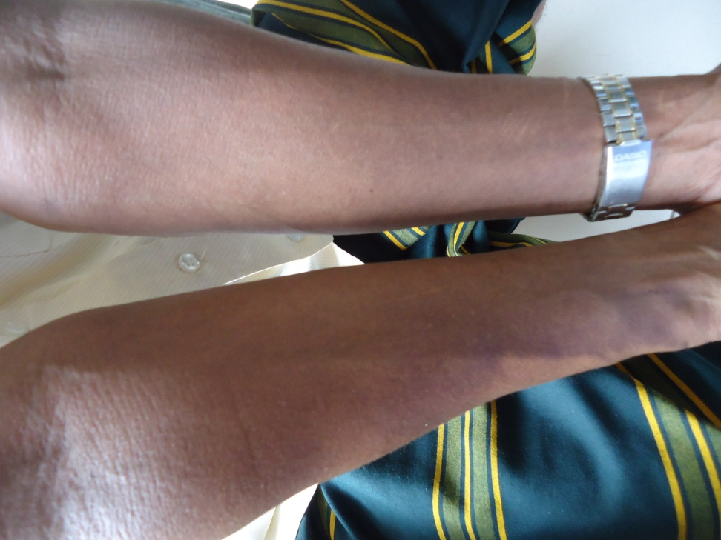
Exfoliative dermatitis

Slide 46
Erythroderma/ exfoliative dermatits
When over 90% body surface area involved by the dermatitis
If scaling prominent – exfoliatve dermatitis
If erythema prominent – erythroderma
A dermatological emergency
Best managed as in patient, refer without delay

Slide 47
Causes for erythoderma/ ED
Eczema/ dermatitis
Psoriasis
Drug reactions
Cutaneous malignancy
Genetic disorders

Slide 48
Complications of ED
Hypothermia
Hypoproteinaemia
Secondary infection
Hypovolaemia
Heart failure

Slide 49
Principles of management
Try to establish cause (history, skin biopsy)
Generous amounts of emollients
Oral steroids (not if underlying cause is psoriasis, use MTX instead)
Correct hypothermia, nutritional deficiency, secondary infections
Need long term therapy

Slide 50
Dermatitis mimics
Tinea incognito
Acute lupus
Cutaneous lymphoma
Leprosy

Slide 51
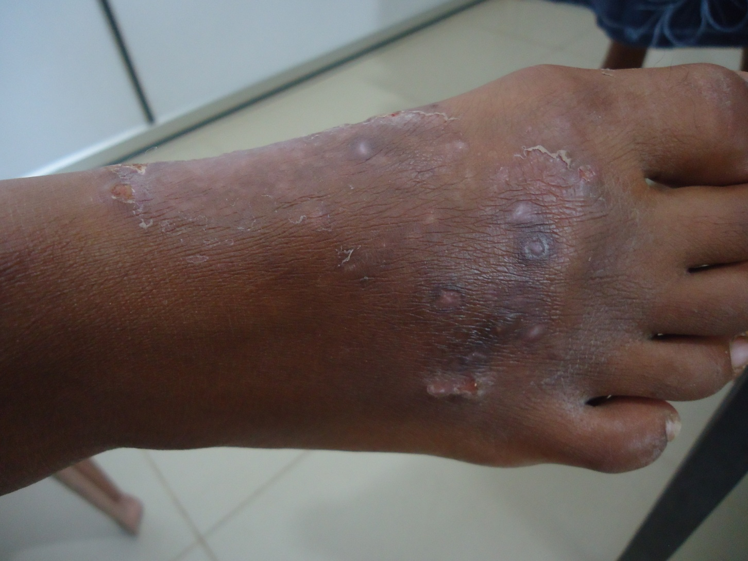
Tinea incognito

Slide 52
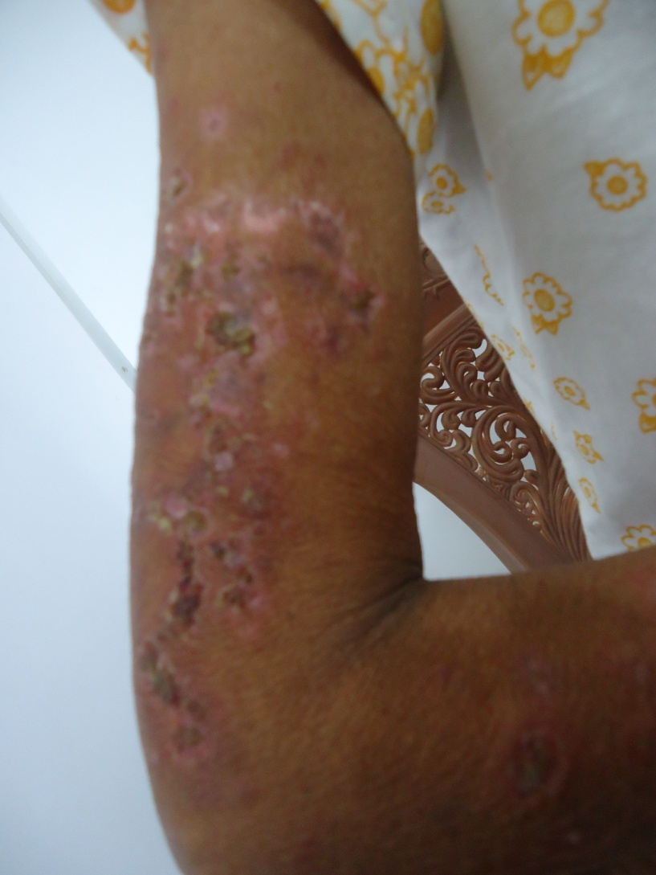
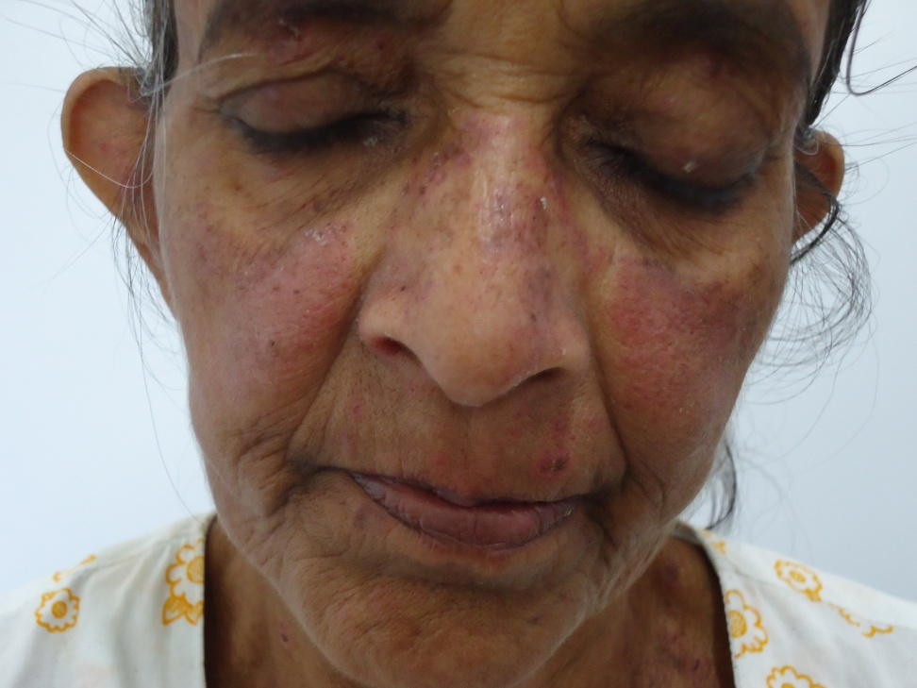
Acute lupus

Slide 53
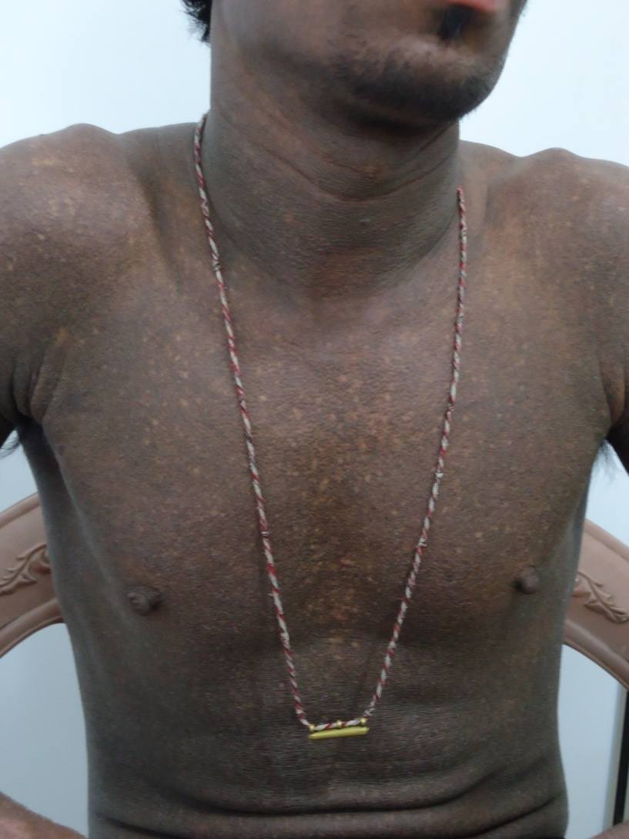
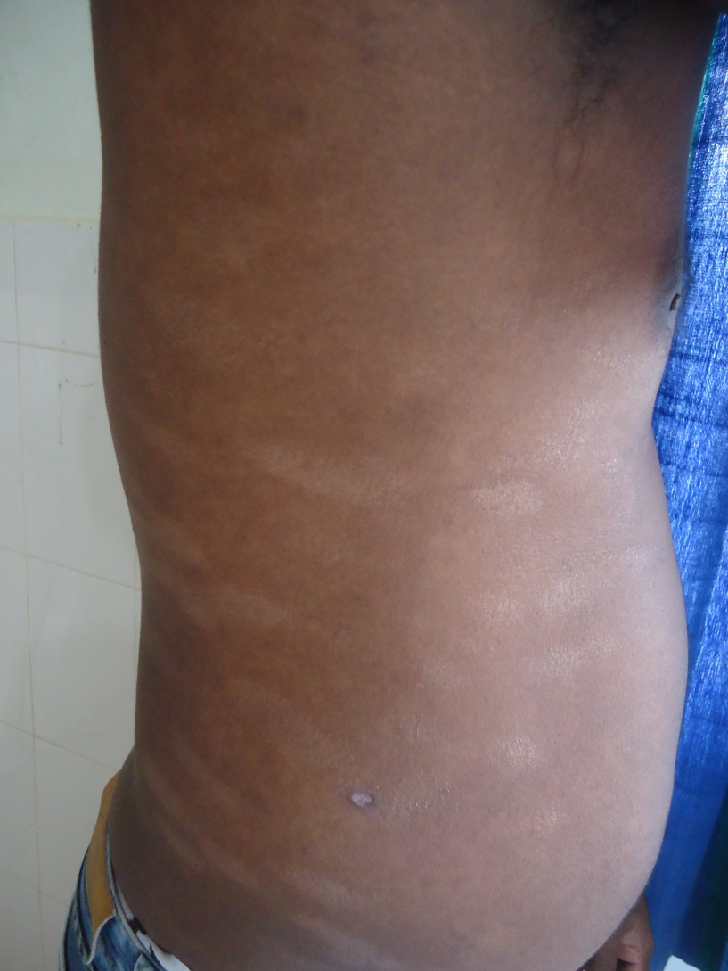
Cutaneous lymphoma

Slide 54
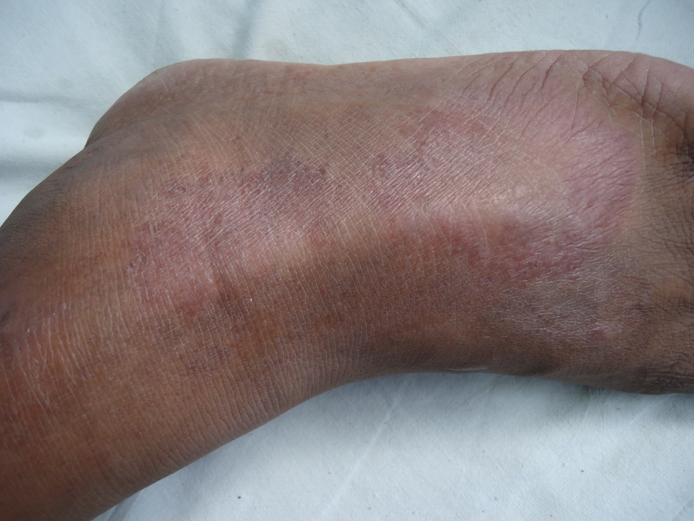
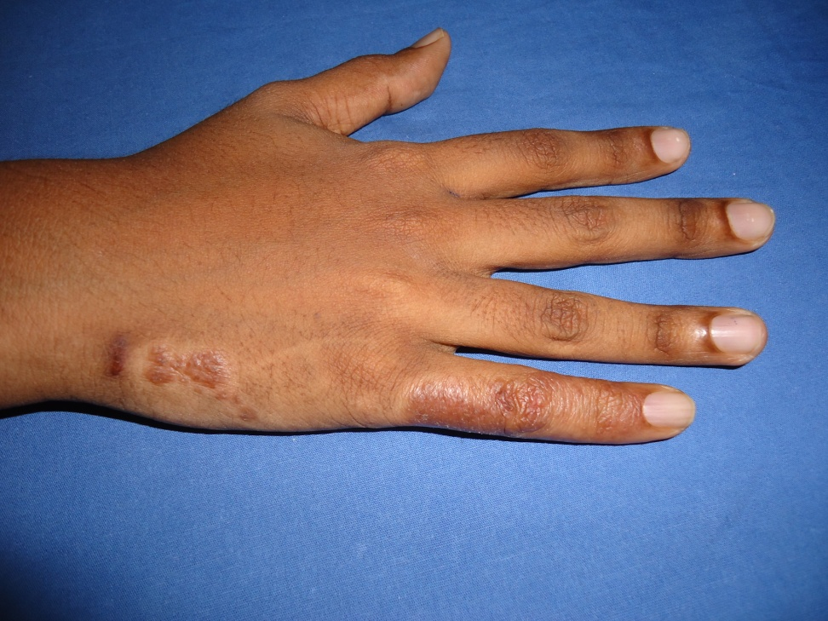
Leprosy

Slide 55

Thank you

